Slide 1
Structure & Methodology for Deliverable 3.5: Developing planning infra structure for the area – designing digital maps on the area –
2nd COORDINATION MEETING

Slide 2
The objective
Deliverable 3.5: 1 common digital map for the area’s vineyard
The deliverable will contribute to define the area’s wine identity by showing the area’s characteristics on a digital map

Slide 3
Partners Involved
LP Agricultural University of Athens (GR)
P2 Institute of Viticulture and Enology (BG)
P6 Agency for Transnational Training and Development – TRANSCOOP (GR)

Slide 4
Application area
District of Haskovo - BG
District of Kardzali - BG
Region Eastern Macedonia and Thrace - GR

Slide 5
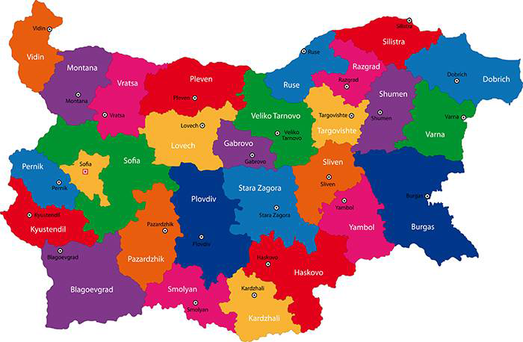
Project Area in BG

Slide 6
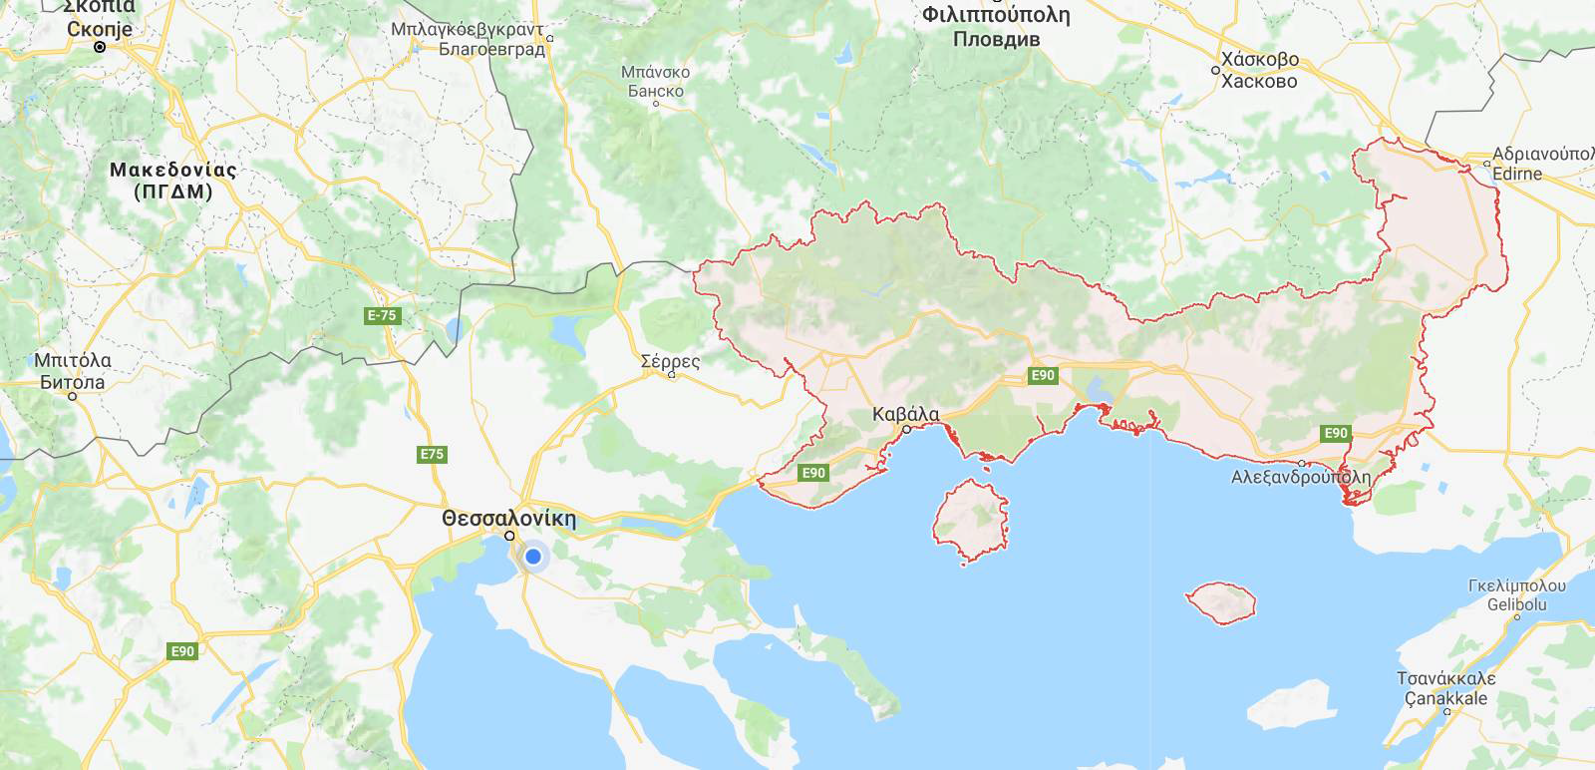
Project area in GR

Slide 7
Important Notes
The digital map will be a common map for the whole project area
Common methodology (referring to the data to be presented on the map) to define

Slide 8
First study results in the region of Eastern Macedonia and Thrace
According to EU Regulations (479 of 2008, 607 of 2009) there are following wine zone categories:
Wine - Zone of Protected Designation of Origin - PDO
Wine - Zone of Protected Geographical Indication PGI (and local wines) at the levels of: Region, Regional Unit, Local Area
Wine - Zone for variety wines
Wine - Zone for table wines

Slide 9
In the Region of Eastern Macedonia and Thrace:
There are no Zones of Protected Designation of Origin - PDO
There are 11 Zones of Geographical Indication PGI, as follows:
2 Zones at Regional Level: Macedonia, Thrace
4 Zones at the Level of Regional Unit: Drama, Kavala, Thassos, Evros
5 Zones at the Level of Local Area: Agora (in Drama), Adriani (in Drama), Paggaio (in Kavala), Avdira (in Rodopi), Ismaros (in Rodopi)

Slide 10
Brief characteristics of the above zones (1)
PGI Macedonia
It is a very large area (with 3 Regions & 13 Regional Units) introduced in 1989. As expected, there is a wide differentiation, both in terms of soil and varieties, but also in terms of climate.
PGI Thrace
The main wine regions are Soufli and the northern part of Evros, Maronia in Rodopi and Avdira in Xanthi. However, it has some very distinctive local varieties, such as the roebean pamidi and the red ones: Mavroudi of Thrace, Carlahanas, Bogialamas

Slide 11
Brief characteristics of the above zones (2)
PGI Drama
Introduced in 1995, it is a remarkable case in Greece's wines. As it started almost from scratch, over the past 20 years it has made a significant progress both in the cultivation of vines and in the production of wine
The PGI Drama is produced at all wineries in the zone.
PGI Kavala
Introduced in 1995, PGI Kavala has the same variety composition as PGI Paggaio, but a wider range of types of wine.

Slide 12
Brief characteristics of the above zones (3)
PGI Thassos
The Thassian wine was of the most known named- wines of the antiquity. During the Ottoman occupation the production of Thassos was so important that the taxes to the Sultan were paid in wine and not in money. Today, the area of wine vineyards in Thassos is small, but able to produce high quality wines

Slide 13
Brief characteristics of the above zones (4)
PGI Evros
It was introduced in 2010. The vineyards are located mainly in the central (Soufli district) and in the northern part, at the border to Bulgaria (Trigono area). The long tradition of Evros in wine growing and wine production is justified by the establishment of the PGI Evros, which is remarkable for the presence of red native varieties of: carlahanades, mavroudi,bogialamades, pamidi.

Slide 14
Brief characteristics of the above zones (5)
PGI Agora
It was introduced in 1995
PGI Adriani
It was introduced in 1996. It is one of the few PGI wines in Greece with only foreign varieties.
PGI Paggaio
It was introduced in 1995. The wine tradition of the area is long and directly related to the worship of Dionysos. The amendment of 2010 extended both the varietal composition and the types of wine that can be produced there

Slide 15
Brief characteristics of the above zones (6)
PGI Avdira
It was established in 1997. The wider area of Avdira has a great archaeological interest and a long wine tradition. Today, it is one of the most dynamic wine-growing regions of Thrace.
PGI Ismaros
It was established in 1997. The area of Maroneia has a long history in wine. Archaeological research has revealed the famous Maroneous or Maronite wine, connected to Cyclop Polyphemus (from the well-known story of Homer's Ulysses)

Slide 16
Data for the map that can be drawn from the studies for the zones PDO & PGI
1. Name of the Zone
2. Characteristics of the Zone, in brief (date of adoption, history, viticultural tradition, etc.)
3. Zone borders
4. Zone Permitted Altitude for the Vines
5. Permitted Greek resp. Bulgarian Varieties
6. Permitted Foreign Varieties
7. Permitted Types of Wines (e.g. white dry, white semi-dry, red dry etc.)

Slide 17
Other data for the map to collect (1)
Α. Wineries in each zone:
For each Winery:
Name of Winery
Address of Winery
Contact details
Name of the Protected Indication produced
PDO / PGI / Variety Wines
Whether the winery is open to visitors
Whether tours to the winery resp. vineyard are offered

Slide 18
Other data for the map to collect (2)
Hours when the winery is open to visitors
Whether a possibility for wine tasting
Whether the winery provides a museum
Whether the winery provides a restaurant
How the winery advertises to the public.
The above data can be collected:
From the competent official Directorates
Upon research to the wineries

Slide 19
Other data for the map to collect (3)
Β. Main Local Native Varieties in each zone
Main Local Native Varieties in each zone
The above data should be found in deliverable 3.2 Selecting main local wine varieties and identifying their characteristics (LP Agricultural University of Athens, P2 Institute of Viticulture and Enology, P5 Federation of Professional, Crafts and Trade Associations of Evros)
Local Native Varieties already adopted by the local wineries
The above data can be collected: upon research to wineries

Slide 20
Thank you for your attention

